Slide 1
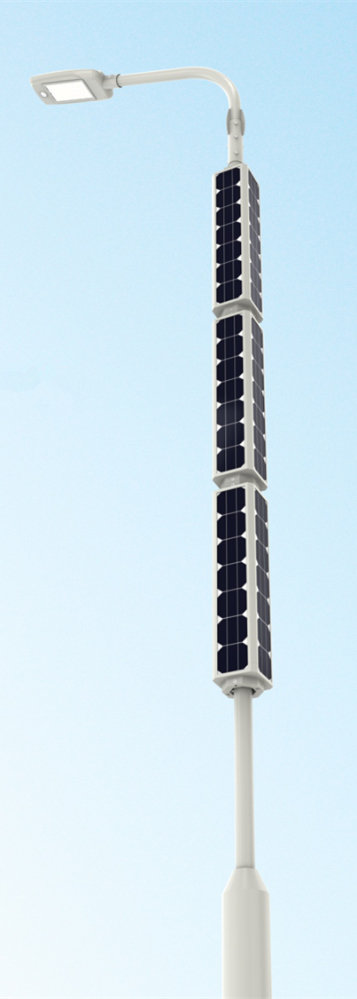

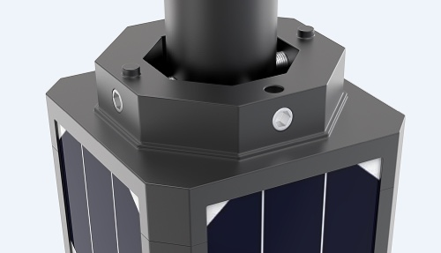
WWW.SINOLSOLAR.COM
Vertical Solar Street Light
2021 Patent Design
2021 NEW

Slide 2



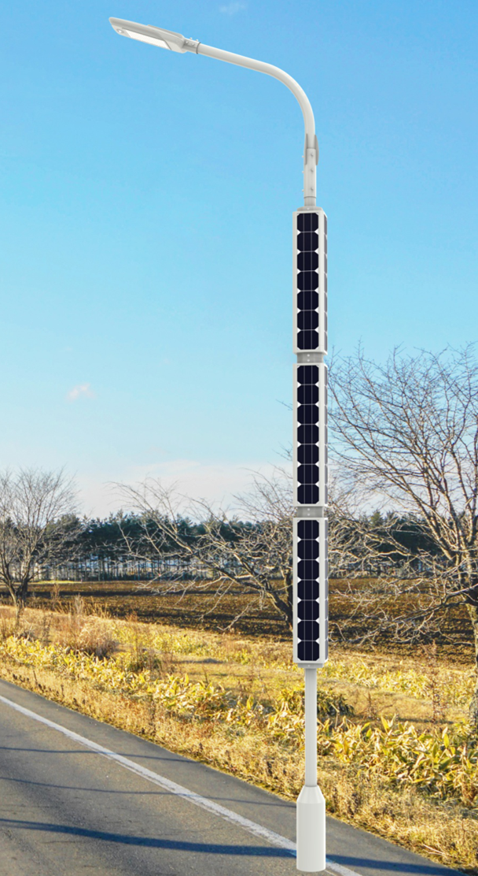












Universal Application
Cylinder PV can be used in any type of poles and designs without dismantling them makes the appli- cation. Poles can be sourced separately, the detachable design with adjustable spacing brack- ets helps the mounting easy in every pole.
Vertical Solar Streetlight
What Is It?
360° Full Day Charging
4 slim solar panels are ﬁxed tightly on a quadrangle frame. so it ensures 50% of solar panel will face to sunshine at any time of the day.
Vertical solar LED street post is an advanced combination with latest technology. It adopts the cylindrical solar modules as a revolutionary design.
Modular Installation
This solar cylinder module is based on modular design concept for easy installation and disassem- bly. It can be quickly and easily mounted on any suitable pole.
Patented Design
Vertical solar streetlight is designed based on advanced concepts and manufactured in high standards. SINOLTECH patent application is under processing.
Solar cylinder is based on modu- lar conception which can be easily mounted to any kind of pole within diameter 140mm, It adopts mono-crystalline solar panel with high eﬃciency up to 21.2% and more than 20 years lifetime. It has a ﬂexible modular design and with much aestheti- cal appearance. And it has a great performance in wind resis- tance than regular solar panel.
Strong Wind Resistance
The cylindrical design reduces the wind resistance area, and each module is directly inserted to the metal frame which is pre-fixed onto the pole for better wind resistance. Very suitable for very windy regions.
Anti Snow Covering
Solar cylinder modules mounted in vertical, it is not easy to be covered by snow as regular solar panel. Ensure enough power can be generated even in very snowy climate.
Easy to Clean
Less dust will fall on surface than regular solar panel. Worker can clean it easily standing on ground with a long handle brush. no need lift. higher work eﬃciency and less maintenance cost.
Design Aesthetics
The relatively large size of solar panels on the pole top has made the solar lighting not an option for the areas where the design aesthetics and decora- tive lighting applications are used.
Vertical Solar Lighting systems is the real answer which is compact and fully integrates on the pole and available in custom colors to match the design of the pole.
The complete solar pole only includes two functional compo- nents including solar cylinder and solar light head which are be connected to each other directly by easy to plug connectors. The battery and solar controller are built inside of light ﬁxture. The powers of solar light heads include 30W,60W,80W to meet most requirements of projects.
Vertical solar street light pole is a premium and advanced product. It is designed specially for these projects concerning a lot on aesthetical appearance with high luminous ﬂux, durable quality system and long time use
1

Slide 3
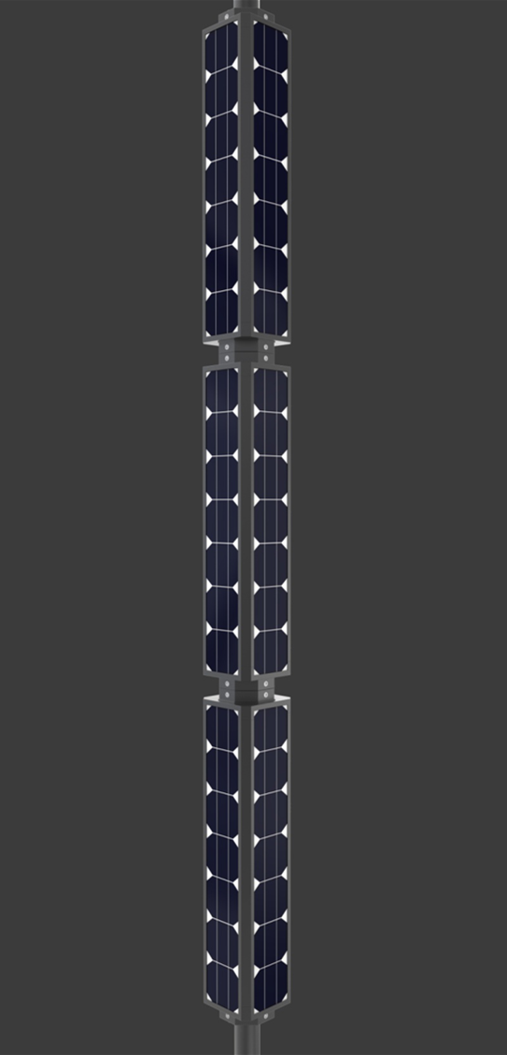
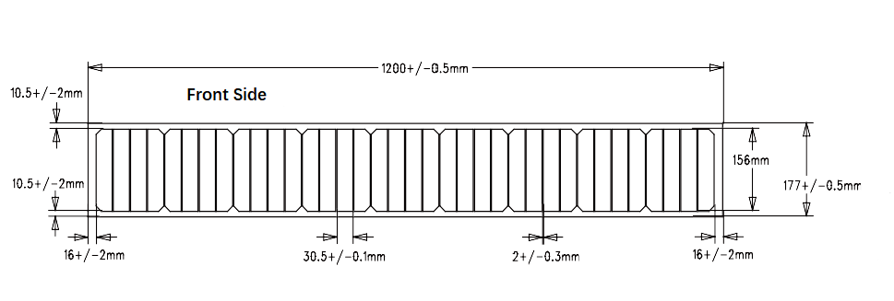
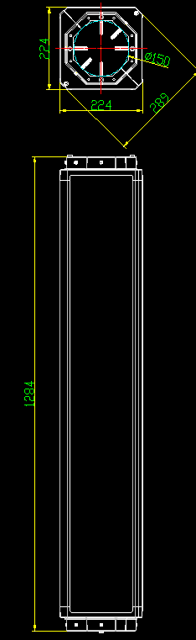
Cylinder Solar Module Data Sheet
Each Module consists of 4PCS single Solar PV Cell, Single PV Cell Specification:
Model number | Q-33
Maximum powr [Pmax] | 33W ±5%
Voltage at Pmax [Vmpp] | 18V±3%
Current at Pmax [Impp] | 1.83A±3%
Open-circuit voltage [Voc] | 21.6V±3%
Short-circuit current [Isc] | 2.01A±3%
Cell type | High efficiency MONO cell
Material | Aluminium+tempered glass
IP Rate | IP65
Solar cell eﬃciency | >20.5%
Cable type | 2.5mm2 with MC4
Operating temperature | -40℃~+80℃
Warranty | 3 years
Life time | >20 years
Single PV Cell Dimensions
Single Module Dimensions(consists of 4 PCS Solar Cell)
Power output: 132 Watt, Unit: mm
2

Slide 4
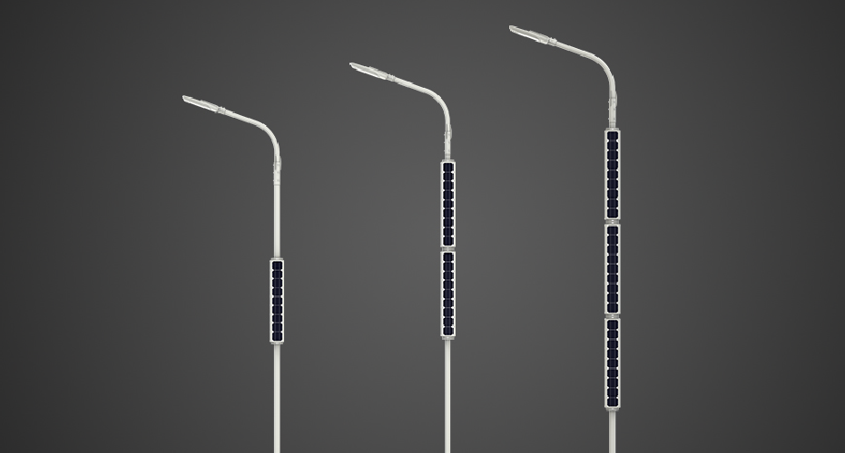

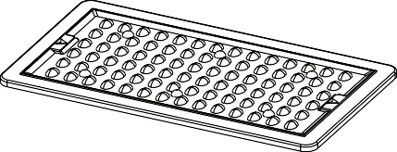
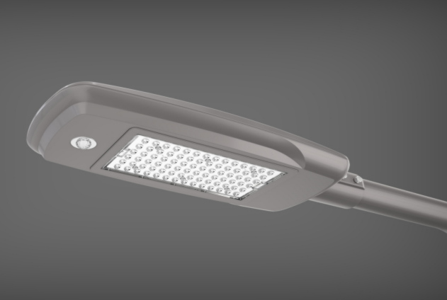
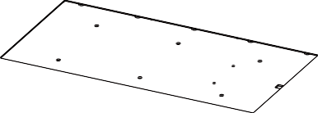
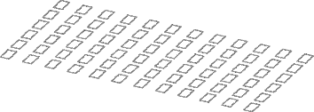
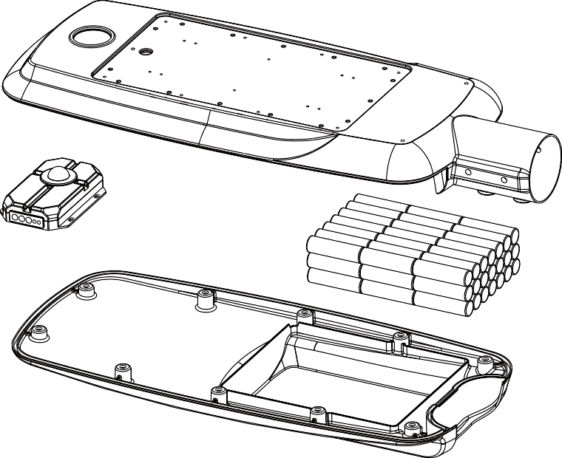
Solar LED Street Light Head
High lumen - Big Battery Backup Series
Key Advantages
ALUMINIUM DIE-CASTING FIXTURE
High quality of light ﬁxture with powder coated and salty fog corrosion resistant, streamlined design appearance.
HIGH LUMENS
Adopt more leds less current drived led board, achieving more than lumens up to 150lm/W output with good lighting performance.
INTEGRATED STRUCTURE DESIGN
LifePO4 battery and high quality MPPT charge controller are built inside of light head ﬁxture combined as a complete unit with easy to plug connectors. Simle and durable connection.
LONG LIFETIME BATTERY
Adopting long time lithium battery, Free of maintainence. Up to 2000 cycles with D.OD. 100% performance,
VARIOUS FUNCTIONS
Human body induction, timing control, light control, bluetooth APP control.
LED
Integrated Optical Lens
Human infrared sensor
Lower Housing
Solar controller
Lithium battery
Upper Housing
3

Slide 5
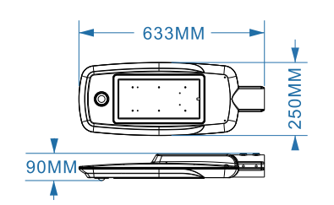
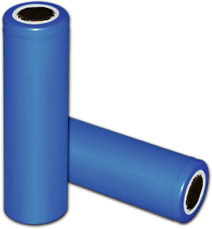
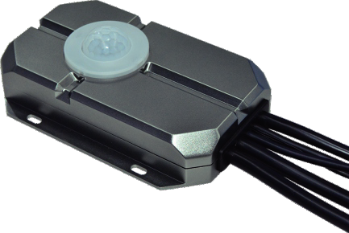
SNV Vertical Solar LED Street Light
Product Speciﬁcations
LIGHT FIXTURE | SNV-30W | SNV-60W | SNV-80W
LED power | 30W | 60W | 80W
Luminous ﬂux | >3,000lm | >6,000lm | >9,000lm
LED | 42Pcs Bridgelux 5050 | 42Pcs Bridgelux 5050 | 42Pcs Bridgelux 5050
Pole height | 6 meters | 8 meters | 10 meters
Install distance | 12-18 Meters | 21-27 Meters | 27-33 Meters
CCT range | 2800-6500 K (tolerance ±300K)
CRI | >75
Beam angle | 140 *70 degrees
Lighting effect | 130-150LM/M
Fixture size | 633*250*90MM
Fixture material | Aluminium die casting
Fixture color | Gray
IP rate | IP66
Motion sensor | Human body induction
Installation size | φ60mm
Connector & cable | 2.5mm2 with easy to plug connectors
Working temp. | -25℃~ +65℃
Warranty | 3 years
BATTERY PACK
Battery type | Ternary lithium battery |  |  | Lithium Battery Pack
Battery capacity | 249.6WH(12V20.8AH) | 436.8WH(12V36.4AH) | 624WH(12V52AH)
Quality level | Brand new A Class
Charge time | 6-8 hours
Discharge time | >36 hours
Battery lifetime | 2000 cycles
D.O.D | 100%
Autonomy | 2 ~ 3 days
BMS | Built-in
Over-DV | 11.5V
Over-DRV | 12.8V
Over-CV | 14.6V
Over-CRV | 13.2V
SOLAR CHARGER
Charge mode | MPPT |  |  | Self-innovated Solar Charge Controller
System voltage | 12V
Ouput current | 0.5A ~ 5A settable
Eﬃciency | >98%
Setting method | by remote control
Installation method | built-in
Operating temp. | -40℃~ +80℃
IP rate | IP68
Solar cylinder module | 132W 18V(4PCS) | 264W 18V(8PCS) | 396W 18V(12PCS)
Regular solar panel | 50W 18V | 70W 18V | 100W 18V
Certiﬁcates | CE, ROHS
4

Slide 6
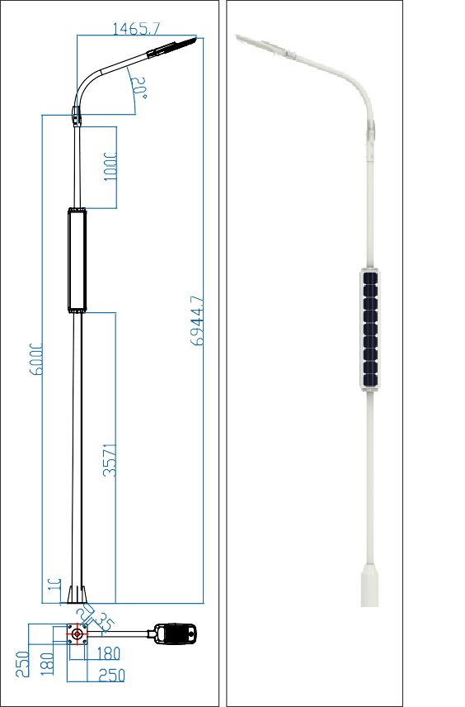
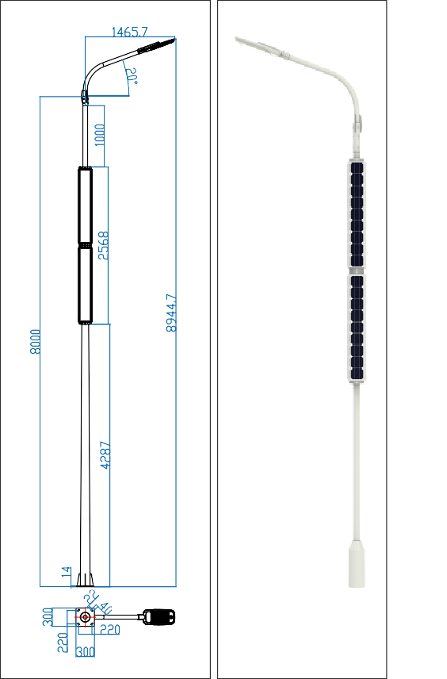
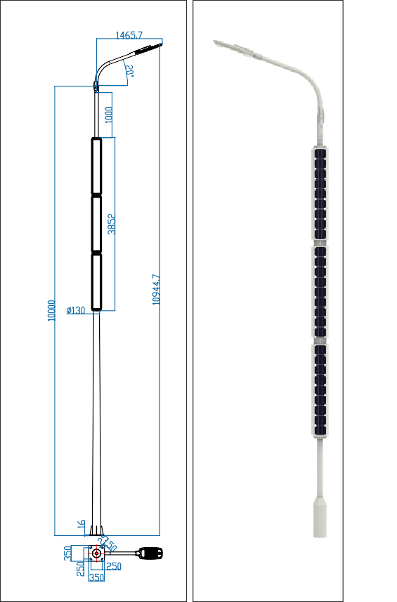
Drawing
Model: SNV-30W
LED: 30W
Cylinder PV: 132W
Lithium battery: 249.6WH
Model: SNV-60W
LED: 60W
Cylinder PV: 264W
Lithium battery: 436.8WH
Model: SNV-80W
LED: 80W
Cylinder PV: 396W
Lithium battery: 624WH
5

Slide 7
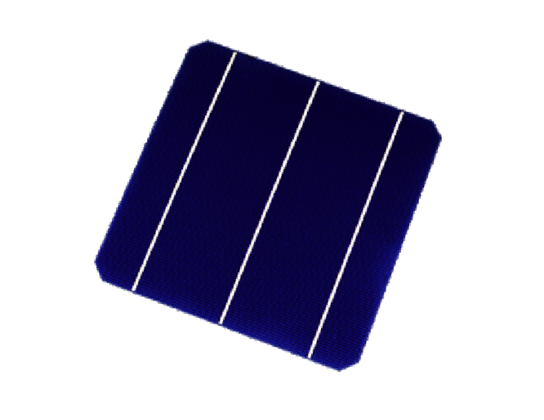
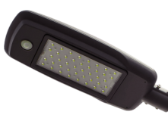
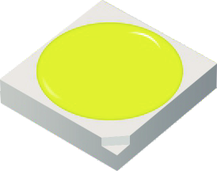
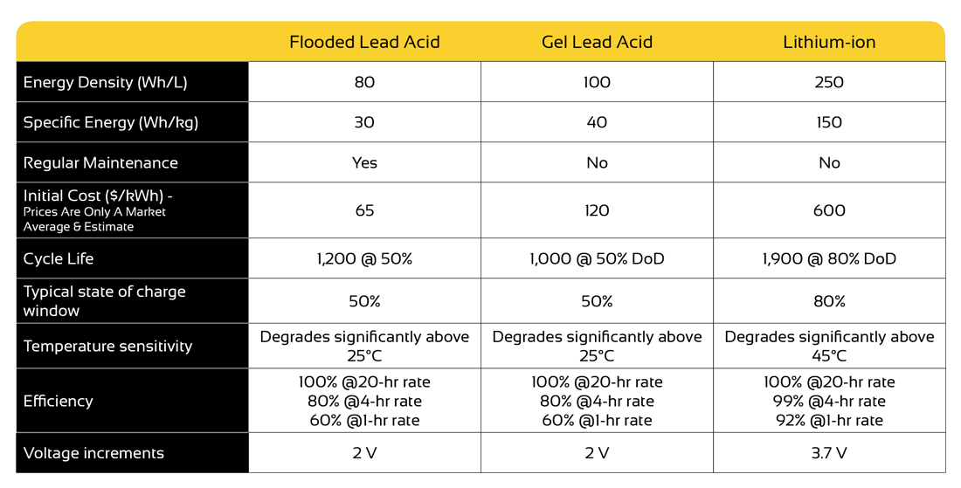
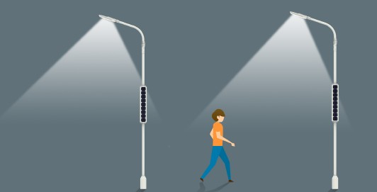
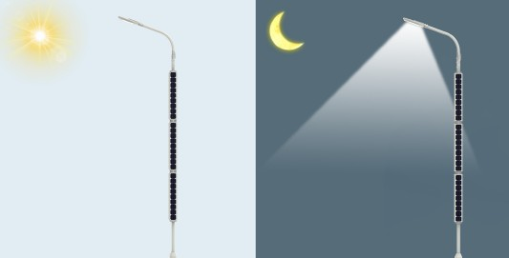
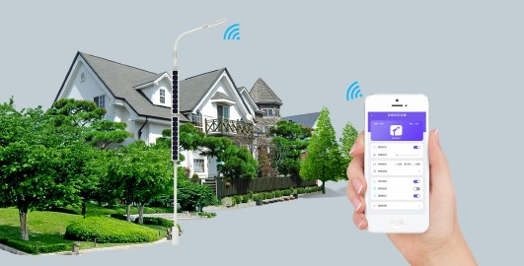
Design Advantages
Key Features & Advantages
Long serive life Lithium Battery, life time over 5 years. With excellent high temperature performance, ensuring the serive life of whole product.
Vertical and streamlined design, easy for installation and maintenance.
Reducing bearing load of lamp head, integrating solar pv with pole, safe under windy and storm weather condition.
Adopting aluminum alloy as main body materials, with excellent rust-proof and corrosion resistance feature.
Maintenance free after installation
•Wide temperature range: -25℃ ~ 65℃
Cost eﬀective
Intelligent timing control function, half working power in second half night to reduce power consumption
Motion sensored, timer and light control, APP control.
Advantages of Lithium Battery
Advantages of Lithium Battery
Lithium-ion solar batteries have a significantly higher cycle life than lead acid batteries do in deep discharge applications.
This means that lithium-ion batteries can support a higher number of complete charge/discharge cycles before their capacity falls under 80%.
Functions
Human body induction
Timer & Light control
Cell phone APP Control
6

Slide 8
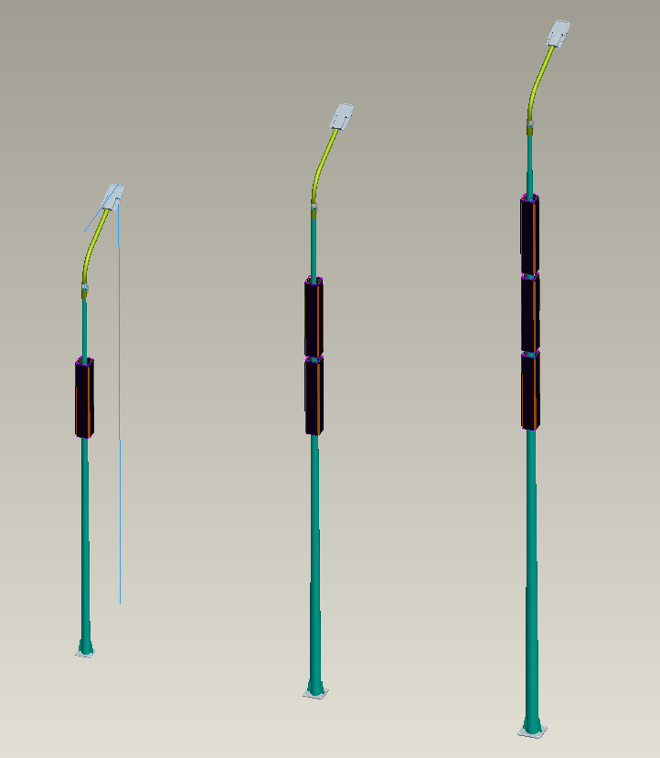

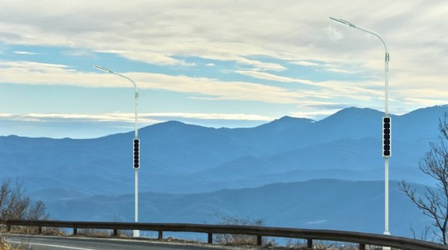
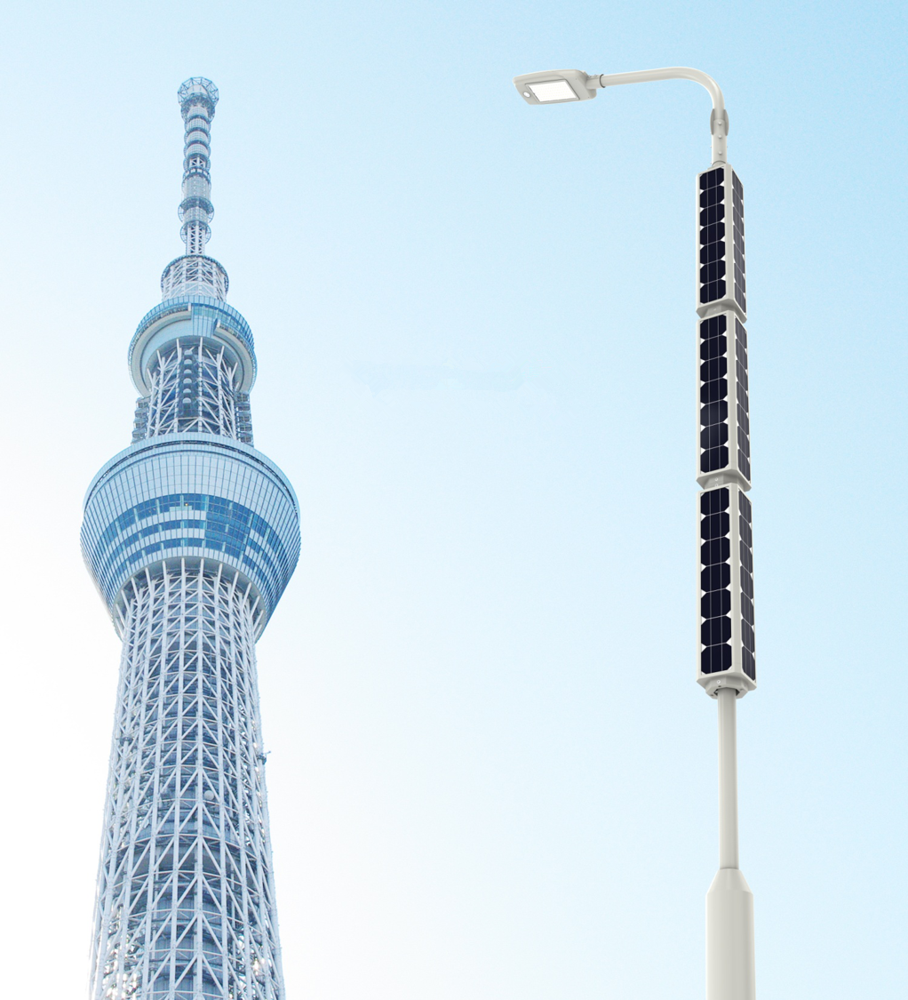
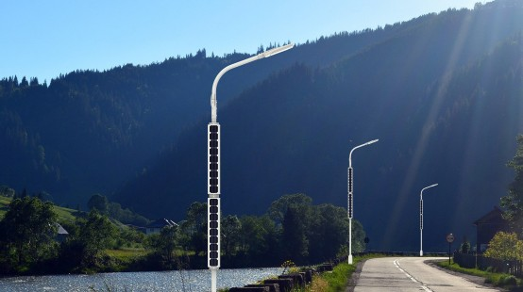
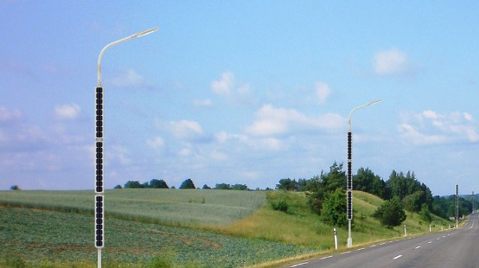
Application Photos
7

Slide 9

Warranty Letter
3 Y E A R S W A R R A N TY
During the ﬁrst three years, SINOLTECH is committed to replace the failed products and undertake the shipping cost, during the 4th and 5th years, SINOLTECH is committed to provide spare parts or complete product for free and shipping cost will be paid at buyer’s expense.
Warranty Terms
The “Warranty Period” will begin at the date of original Product purchase form either SINOLTECH, or an authorized SINOLTECH Distributor/Dealer. SINOLTECH will repair or replace product covered under this warranty with components at SINOLTECH’s election or discretion. Advances in technology may lead to “better or advanced” products being selected for replacement.
This Warranty is further conditioned on the purchaser contacting SINOLTECH during the warranty period between normal business hours to review the issue and initiate the Returned Merchandise Authorization (RMA) process. This must be done prior to the return of any defective product. Only SINOLTECH manufactured products may be returned through the SINOLTECH RMA process. No defective products, SINOLTECH or otherwise, It will be returned to purchaser. The SINOLTECH RMA form must be legible and completed in detail prior to approval for return. The SINOLTECH Warranty is further conditioned and will only apply to SINOLTECH products that are properly installed. This includes wiring and connection to proper approved components and product working environments.
This Warranty is void and does not apply to products that fail as a result of neglect, mistake, misuse, alteration, improper installation or implementation.
This includes but is not limited to: improper wiring, installation under improper and non-approved operating environments such as temperature, humidity or voltage conditions; improper installation using components that are not approved or are not SINOLTECH manufactured products. Installation and usage of SINOLTECH products should only be completed in association and complete knowledge of all necessary and related codes, standards
and instructions of installation. It is the responsibility of the purchaser to obtain all necessary approvals and to understand the product’s intended use and all relevant instructions, recommendations, and guidelines for the proper installation, use of any SINOLTECH product and related “manufactured products,” used in conjunction with . The accuracy and completeness of any statements, technical information and recommendations in any form of product literature or instructions are not guaranteed, are not part of this Warranty, and does not in any way constitute a warranty. The purchaser is responsible for suitability of installation and full implementation and must determine potential applications and installations independently.
Warranty Compensation will be based on ”usage factors and time in use ” and “ Technology Value,” and will be pro-rated based on this and information collected via the RMA process. What is not covered under this Limited Warranty is defects of any kind caused or created by improper installation of any kind; damage caused during shipping to purchaser or beyond “acts of Nature or God. SINOLTECH will not cover additional labor costs or Warranty such labor associated with replacement products. This Warranty document represents the only express or implied Warranty-no other warranties exist.
Remark: SHANDONG SINOLTECH INTERNATIONAL CO., LTD reserves the right of ﬁnal explanations.
8

Slide 10
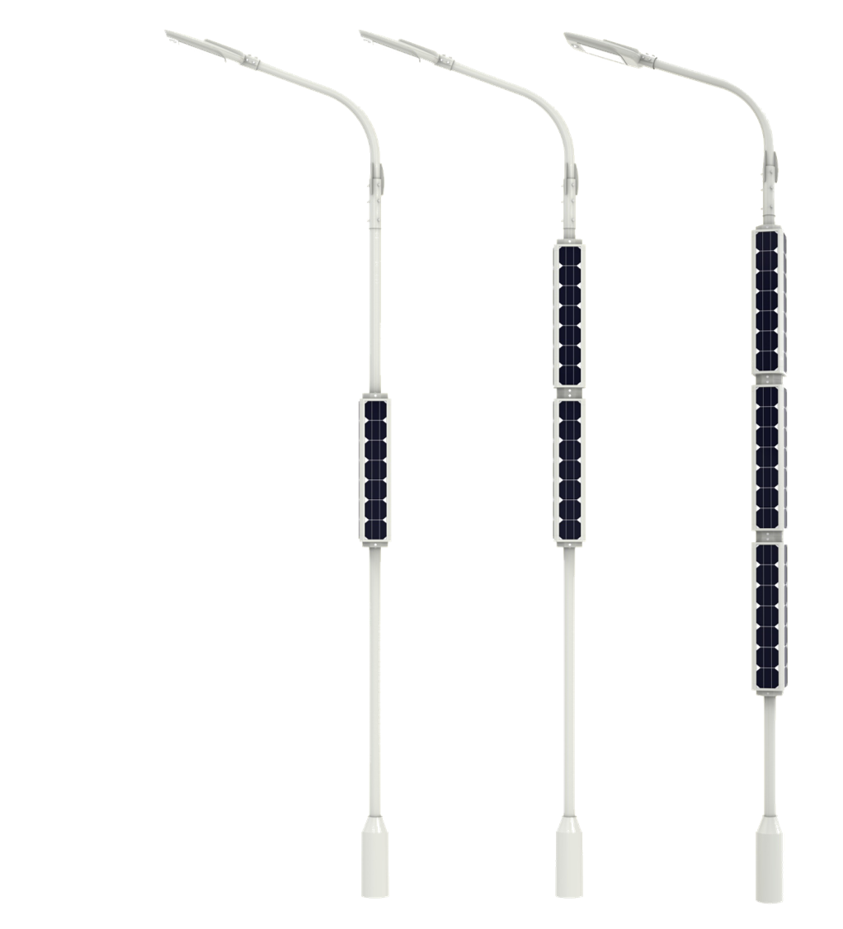
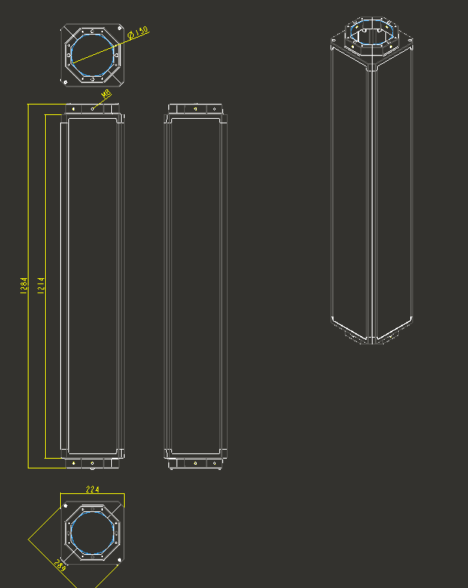


Contact SINOLTECH
UNIQUE DESIGN VERTICAL SOLAR LED STREET LIGHT
2021 SINOLTECH PATENT
SHANDONG SINOLTECH INTERNATIOANL CO., LTD
Jinan Office: Rm 2003-C, Unit 1, Suite 6, Dinghao Plaza, Gaoxin District, Jinan 250000, CHINA
Shenzhen Office: 8-2 Industrial area, South Huaide Road, Fuyong Road, Bao'an district, Shenzhen CHINA
P: +86 153 1880 7707 | E: susan@sinoltech.com |
W: www.sinoltech.com | www.sinolsolar.com
Skype: SINOLTECH | WhatsApp: +86 153 1880 7707

